Slide 1


Slide 2




Cross Platform native User Interfaces with Xamarin.Forms
- Udara Alwis

Slide 3







I am Udara Alwis
Xamarin Developer / Enthusiast
Tech Blogger / Speaker
theconfuzedsourcecode
.wordpress.com
github.com/UdaraAlwis
linkedin.com/in/UdaraAlwis
Notes:
My name is Udara Alwis. I’m a Xamarin Developer here in Singapore, and guilty as charged I’m a crazy Xamarin enthusiast.
I’ve got some mad love for Mobile Development and Mobile User Experience Engineering
Of course I’m a Microsoft fan boy. There goes by saying I’m still 24 years old.
When I’m not coding, I go on adventures, running, cycling, skateboarding.. All that fun stuff!

Slide 4
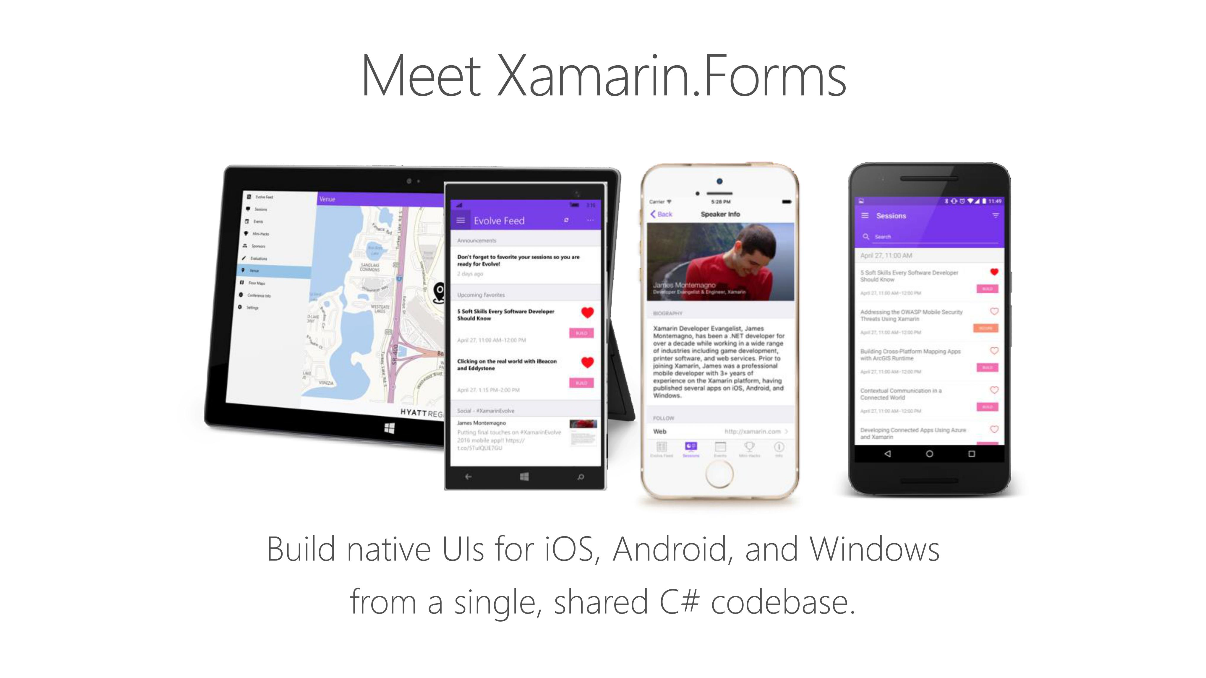

Slide 5
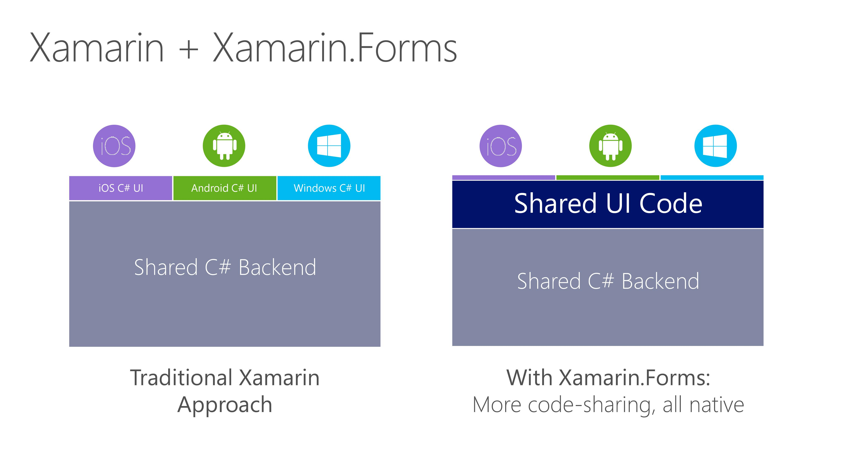

Slide 6
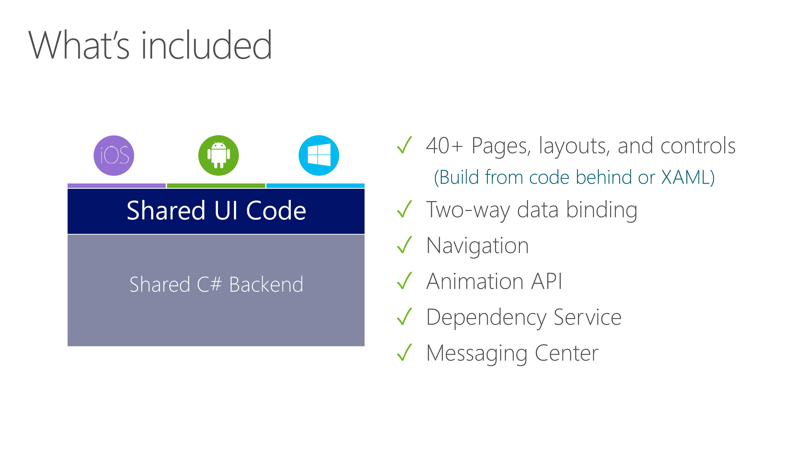

Slide 7
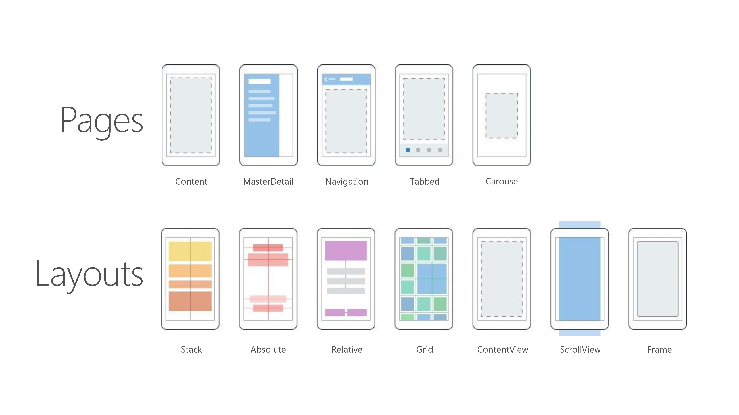

Slide 8
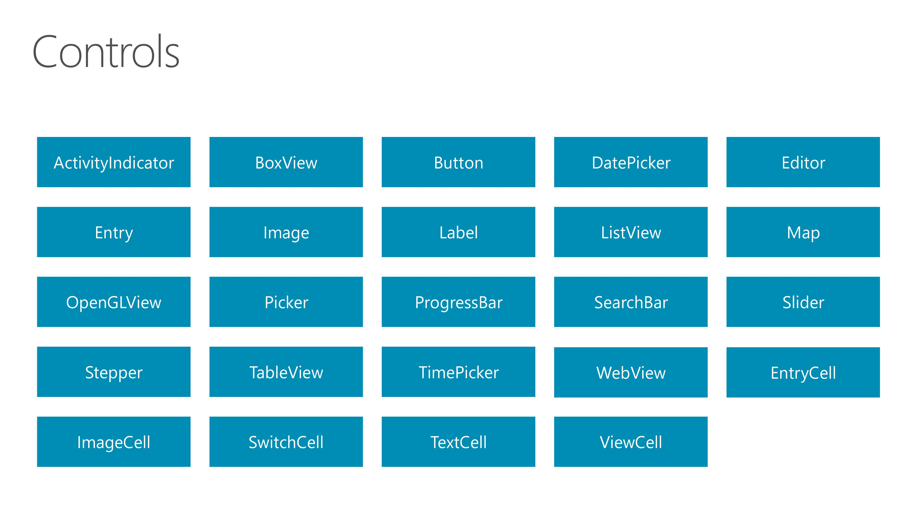

Slide 9


Slide 10
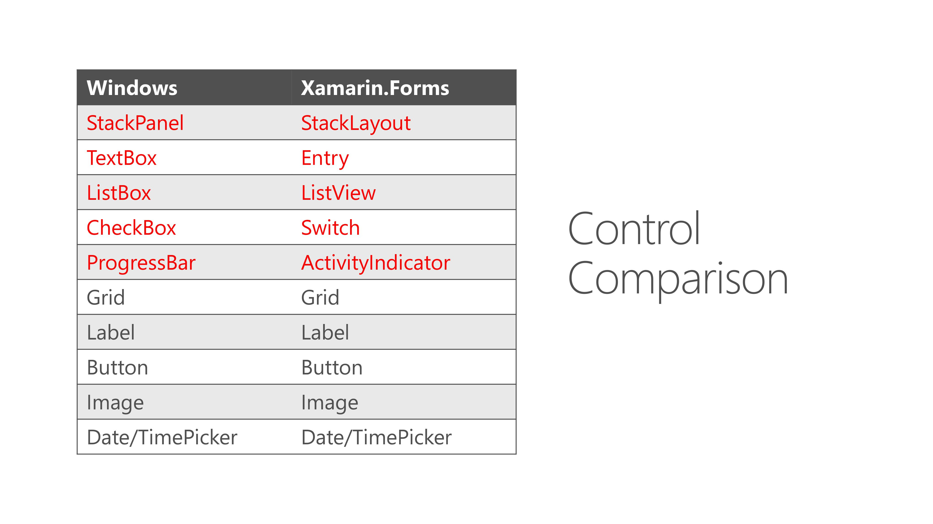

Slide 11
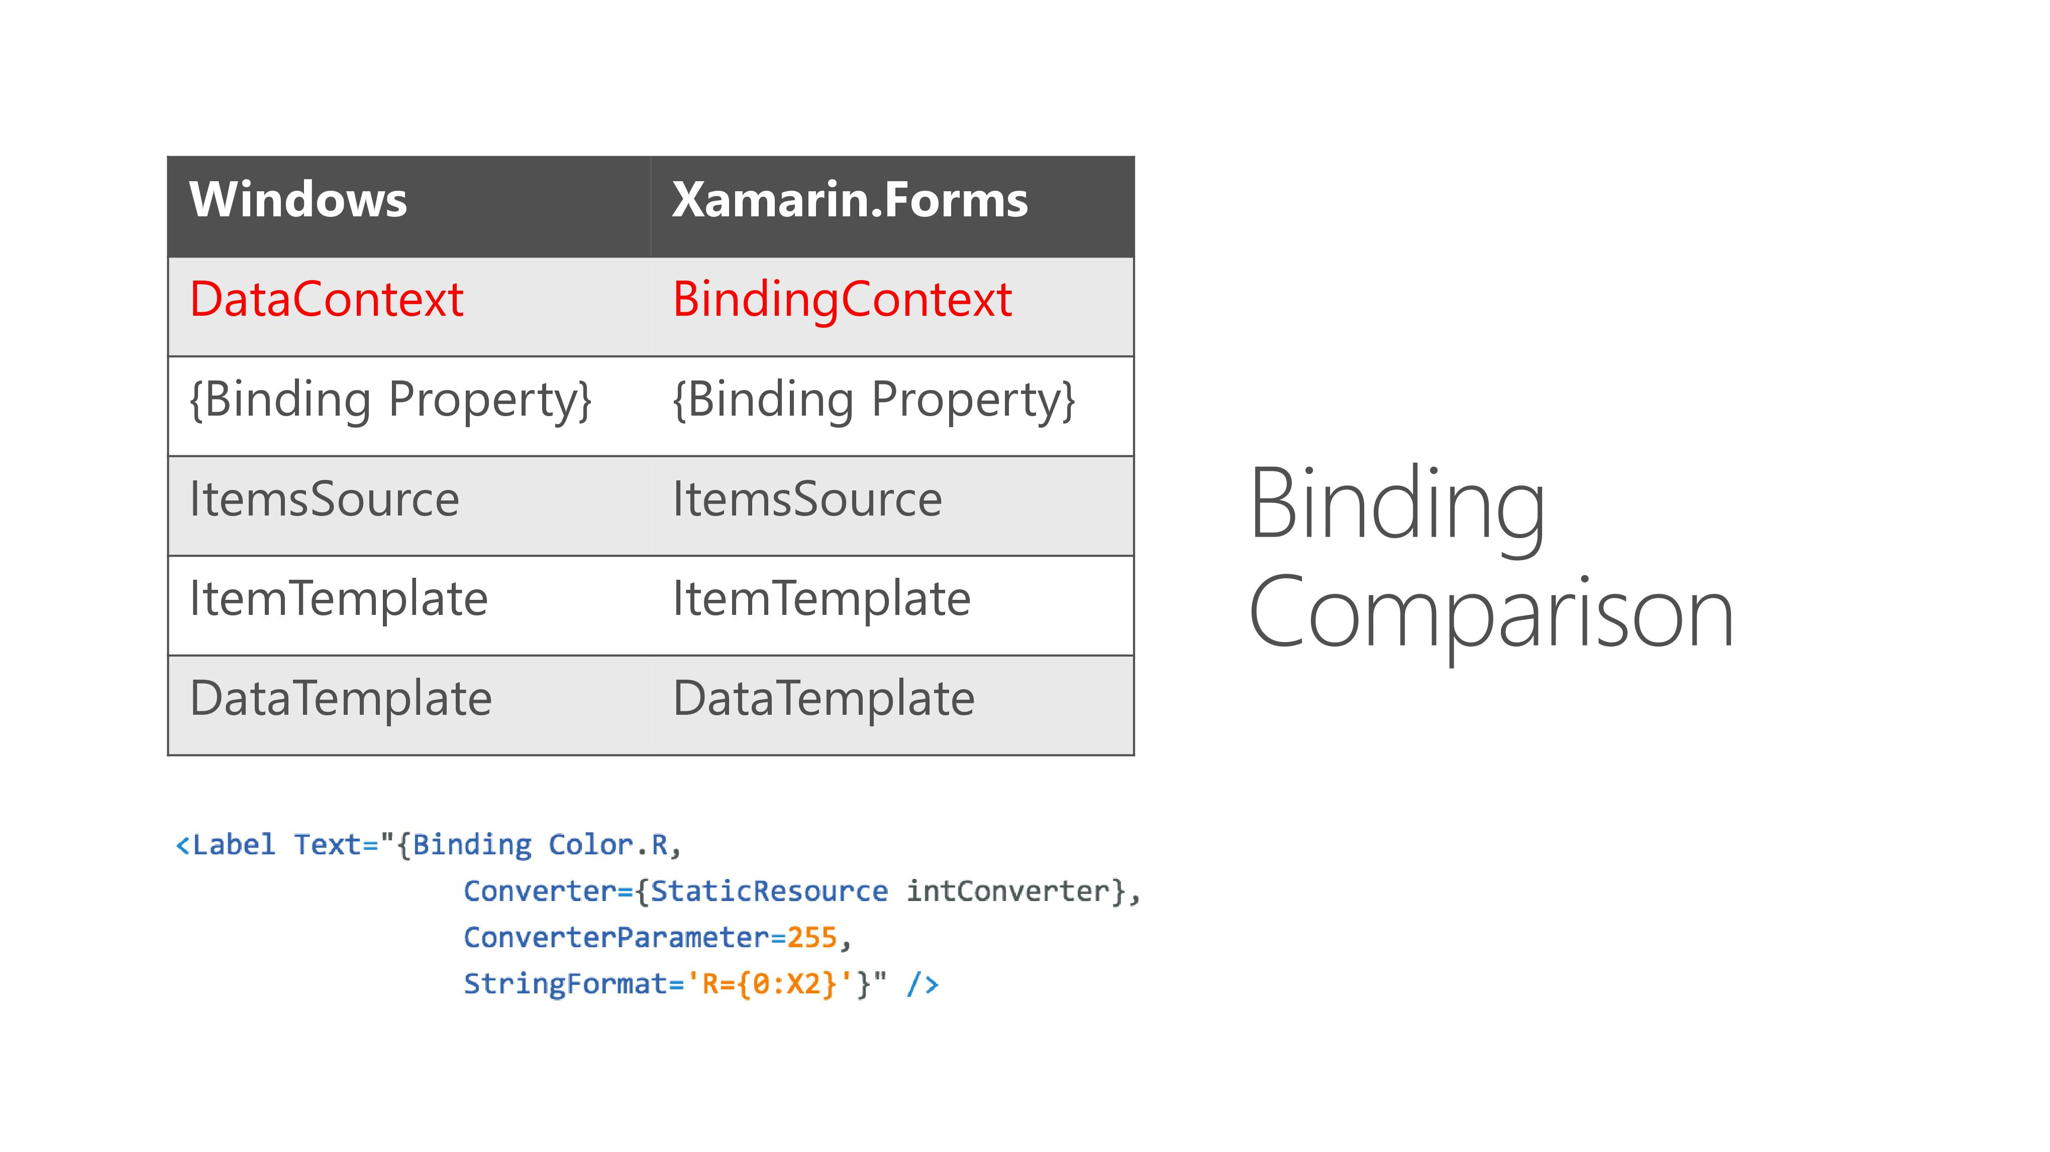

Slide 12
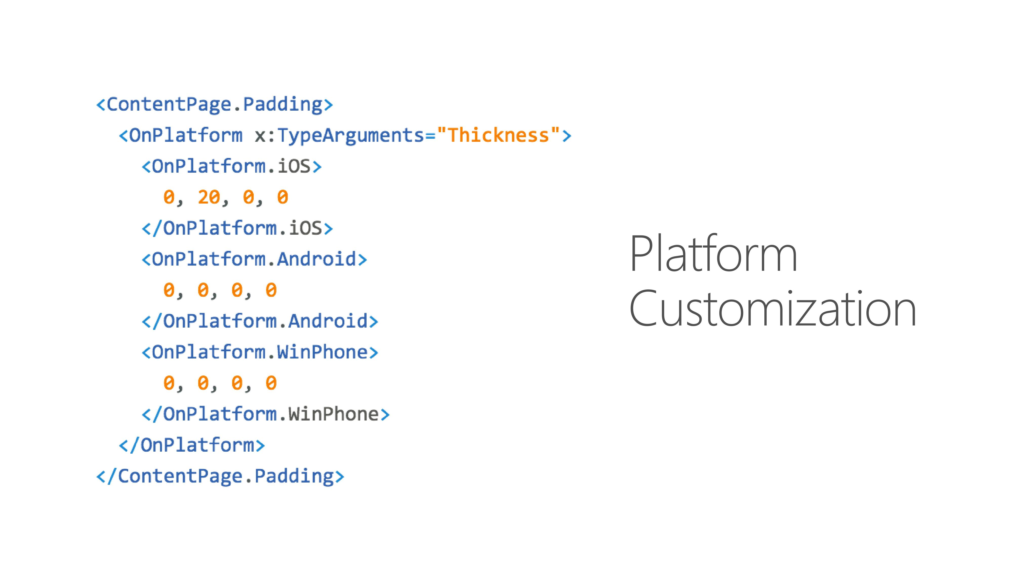

Slide 13
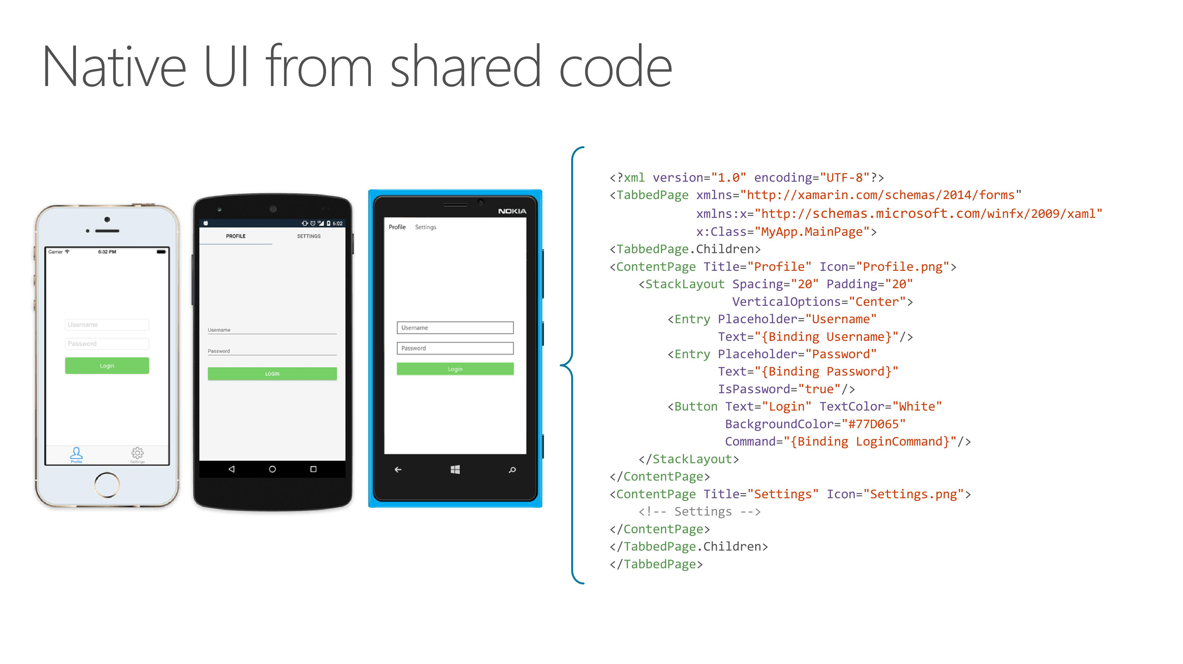

Slide 14


Slide 15

Latest and Greatest in Xamarin.Forms?

Slide 16
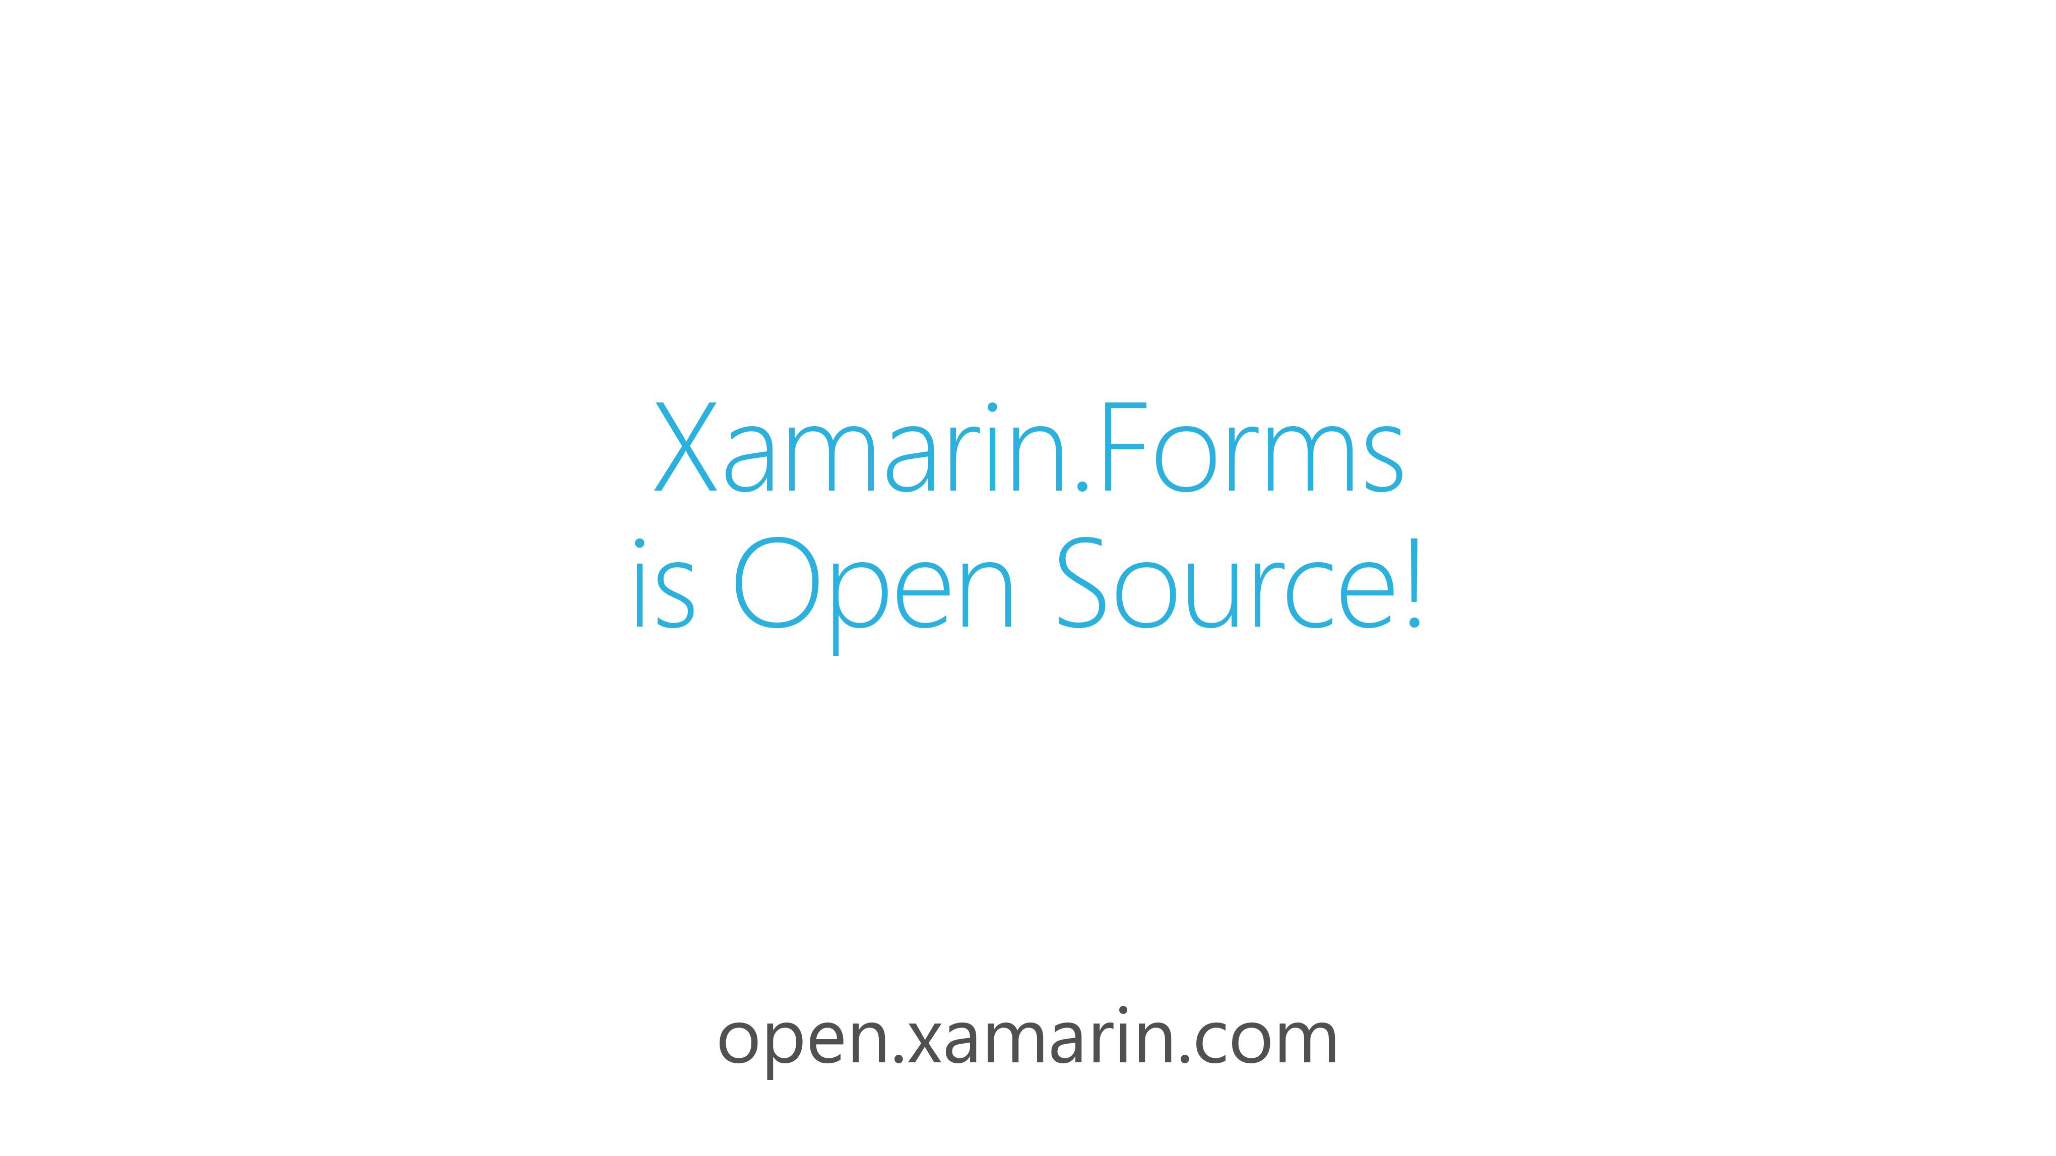

Slide 17
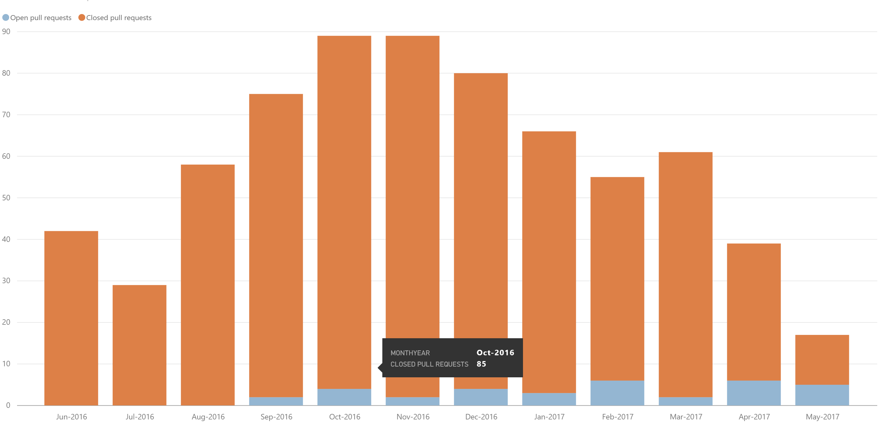
Community
Public Roadmap: aka.ms/xfroadmap
70 contributors
700 merged pull requests
37 evolution proposals

Slide 18
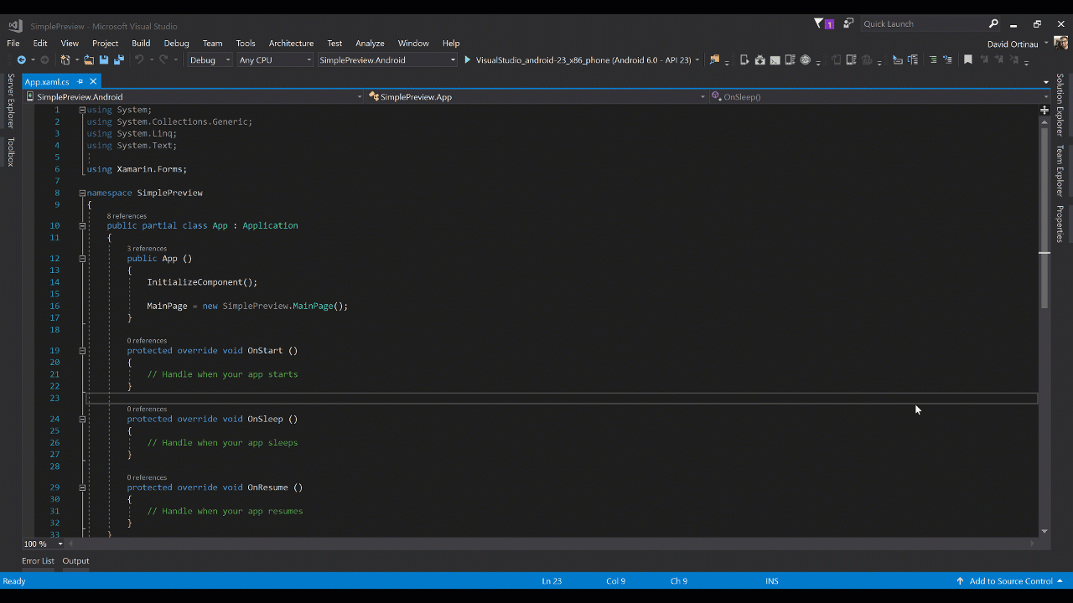
Xamarin.Forms Previewer
Visual Studio for Mac & Windows 2017

Slide 19
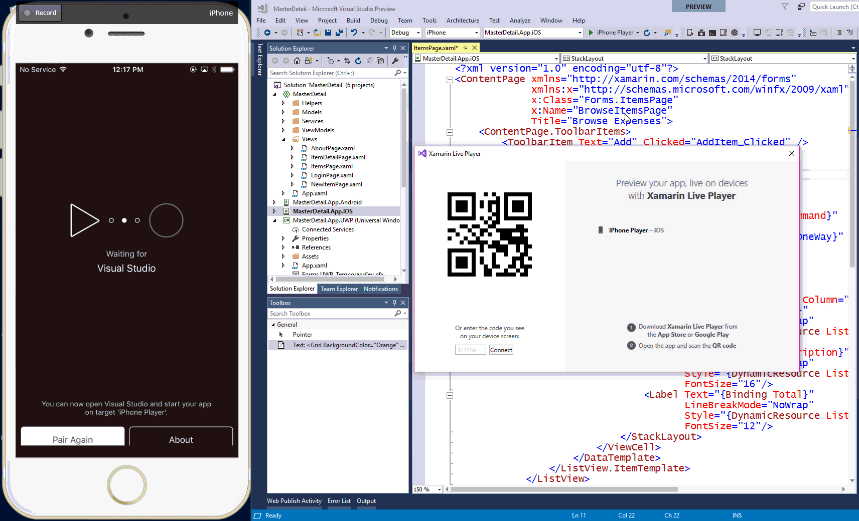
Xamarin Live Player
with Xamarin.Forms
xamarin.com/live

Slide 20
Layout Compression
Remove unnecessary nesting of the Layout Hierarchy

Slide 21
Forms
Grid
StackLayout
ContentView
Button
Grid
Label
Label
WebView
Button
Image
ScrollView
Image
12
Platform
Panel
Panel
Panel
ButtonRenderer
Panel
LabelRenderer
LabelRenderer
WebViewRenderer
ButtonRenderer
ImageRenderer
ScrollViewRenderer
ImageRenderer
TextBlock
Button
WebView
Label
Button
Image
Image
19
Notes:
Source Credit: David Ortinau

Slide 22
Platform+Compression
12
19
Panel
ButtonRenderer
LabelRenderer
LabelRenderer
WebViewRenderer
ButtonRenderer
ImageRenderer
ScrollViewRenderer
ImageRenderer
TextBlock
Button
WebView
Label
Button
Image
Image
16
Notes:
Source Credit: David Ortinau

Slide 23
Fast Renderers
Flattening the Native Control Hierarchy

Slide 24
Forms
Button
Platform
ButtonRenderer
Button
Notes:
Source Credit: David Ortinau

Slide 25
Forms
Grid
StackLayout
ContentView
Button
Grid
Label
Label
WebView
Button
Image
ScrollView
Image
12
Platform+Compression+Fast Renderers
Panel
ButtonRenderer
LabelRenderer
LabelRenderer
WebViewRenderer
ButtonRenderer
ImageRenderer
ScrollViewRenderer
ImageRenderer
WebView
10
Notes:
Source Credit: David Ortinau

Slide 26
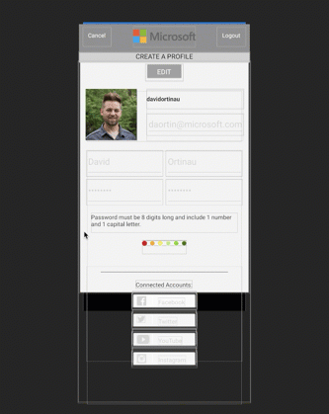
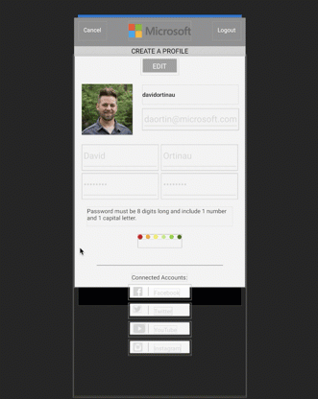
Default:
130 Renderers
Layout Compression + Fast Renderers:
70 Renderers
Notes:
Source: https://blog.xamarin.com/3-big-things-explore-xamarin-forms-2-5-0-pre-release/

Slide 27
Native View Declarations
Adding Bindable Native Views Directly to XAML

Slide 28
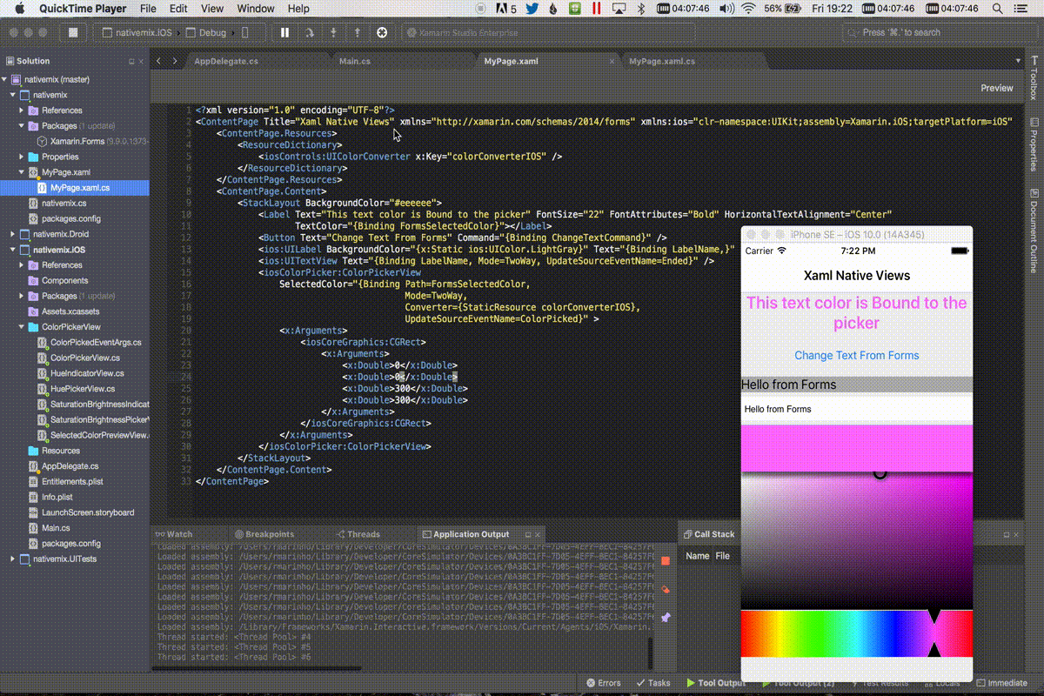

Slide 29
Page Embedding
Embedding Xamarin.Forms in Xamarin Native

Slide 30
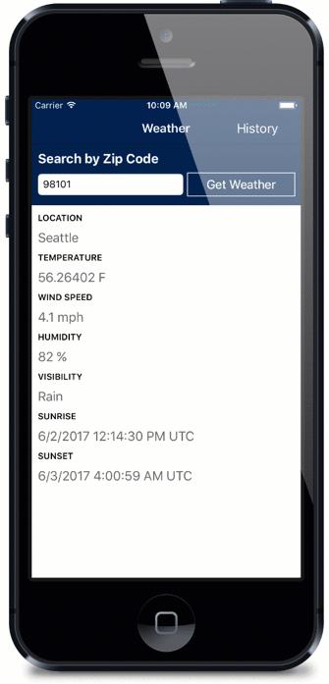
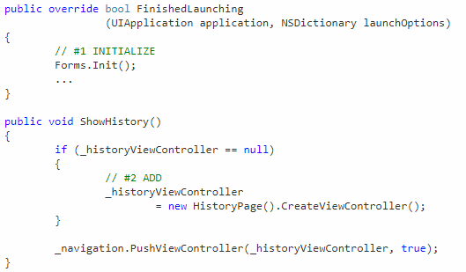

Slide 31
New Backends:

Slide 32
New Backends: Tizen

Slide 33
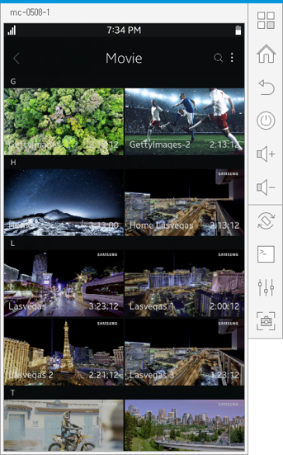
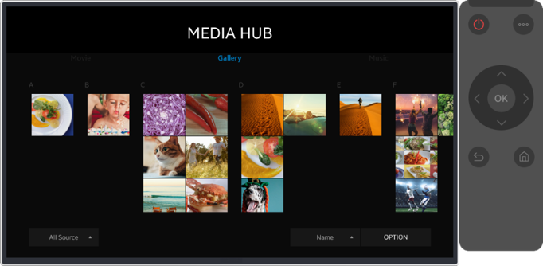

Slide 34
New Backends: WPF

Slide 35
New Backends: GTK#

Slide 36
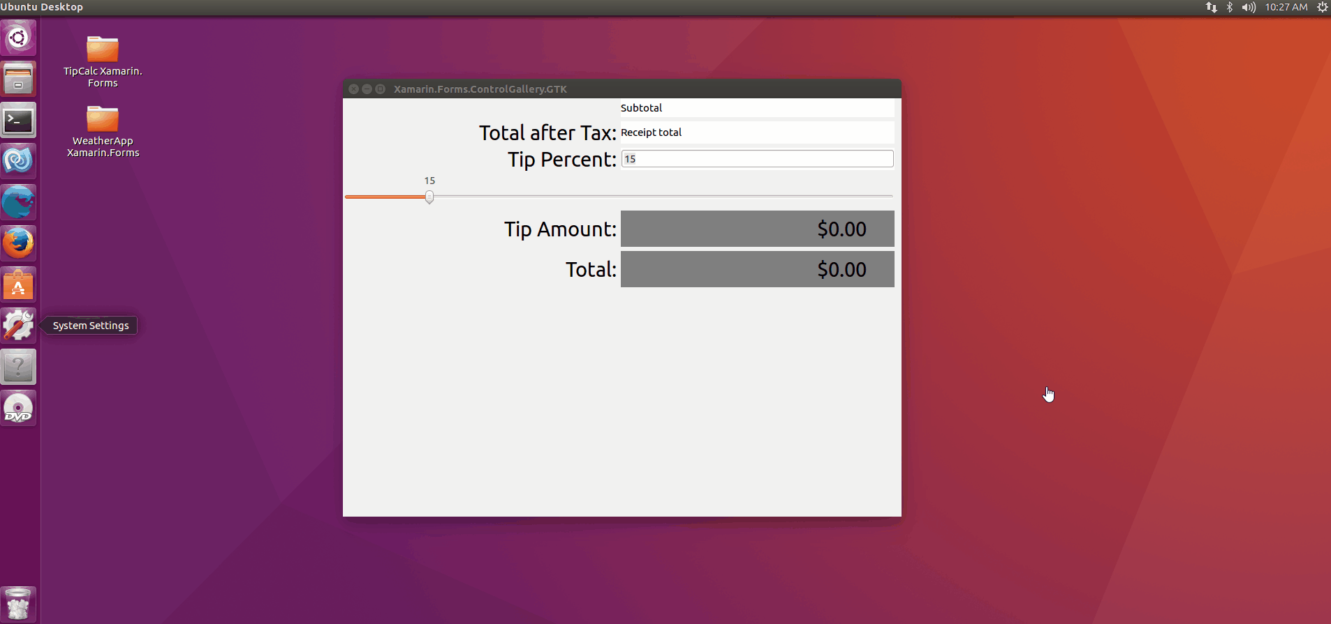

Slide 37
New Backends: macOS

Slide 38
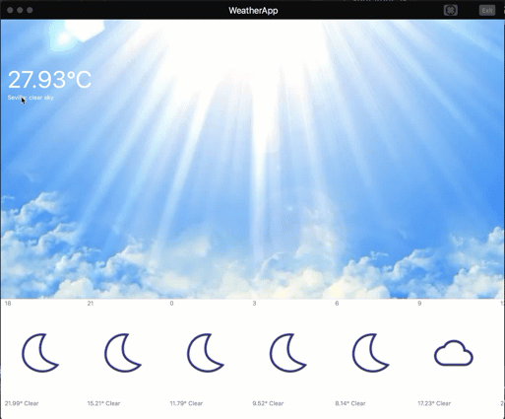

Slide 39
Thank You!
For Weekly Xamarin Articles check out my blog, https://theconfuzedsourcecode.wordpress.com
Udara Alwis
CODENAME: [ÇøŋfuzëÐ SøurcëÇødë]

